Slide 1


Generalized Twin Gaussian Processes using Sharma Mittal Divergence
Mohamed Elhoseiny and Ahmed Elgammal
Rutgers University, USA
t h e s t a t e u n i v e r s i t y
o f n e w j e r s e y

Slide 2

Agenda
1
Introduction
2
Sharma Mittal Divergence between Gaussian Distributions
3
Sharma Mittal TGPs (SMTGP)
4
Theoretical Analysis of SMTGP
5
Experiments
5
Conclusion and Future Work
Notes:
Let's introduce the problem in more detrails.

Slide 3
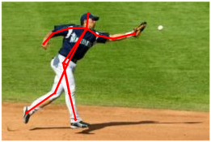
Introduction
Growing interest in mutual information measures due to their wide range of applications in Machine Learning and Computer Vision
Human Pose Estimation
Image Reconstruction
Object Detection, and many others
Sharma-Mittal (SM) divergence from Physcis community is a generalized mutual information measure for the widely used
Re’nyi
Tsallis
Bhattacharyya,
Kullback-Leibler (KL) relative entropies.
Notes:
Ass a slide with some pictures here for importance of Entropy measures

Slide 4
Goal
Study Sharma-Mittal (SM) divergence as a cost function in the context of the Twin Gaussian Processes
generalizes over the KL-divergence without computational penalty.
Study properties of Sharma-Mittal TGP through a theoretical analysis, which covers missing insights in the traditional TGP formulation.
Generalize this theory based on SM-divergence instead of KL-divergence which is a special case.
Notes:
We start by the question of our study which is......
This is basically one way to model the problem, we started our talk with

Slide 5
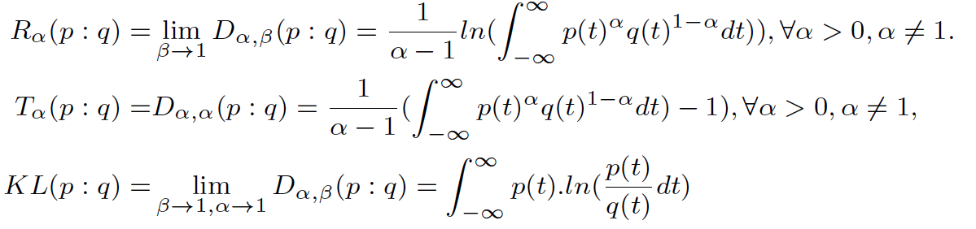
Sharma Mittal Divergence
Re’nyi:
Tsalls:
KL :
Bhattacharyya
Relation to other relative entropy measures
Notes:
We start by the question of our study which is......
This is basically one way to model the problem, we started our talk with

Slide 6
Contribution
A simplified version of SM divergence between two Multivariate Gaussians that could be used in a general setting.
Theoretical understanding of TGPs using Sharma Mittl divergence.
Interpretation of its two parameters in structured regression These two parameters could be interpreted as
Distribution bias α
Divergence order β
Probabilistic causality direction of the SM objective function.
Uncertainty measure could be associated with each structured output prediction.
Notes:
Perhaps, some terminologies are unclear and that's what we are going to conver in our introduction.

Slide 7
Agenda
1
Introduction
2
Sharma Mittal Divergence between Gaussian Distributions
3
Sharma Mittal TGPs (SMTGP)
4
Theoretical Analysis of SMTGP
5
Experiments
5
Conclusion and Future Work
Notes:
Let's introduce the problem in more detrails.

Slide 8
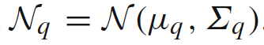
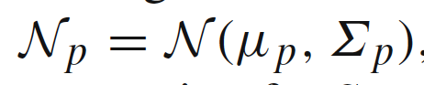
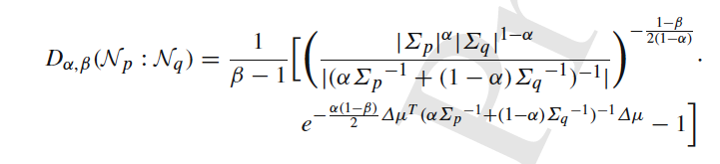
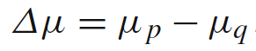
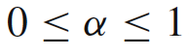
Sharma Mittal Divergence between two Gaussians
(Nielsen etal 2012) closed form expression
Notes:
Perhaps, some terminologies are unclear and that's what we are going to conver in our introduction.

Slide 9
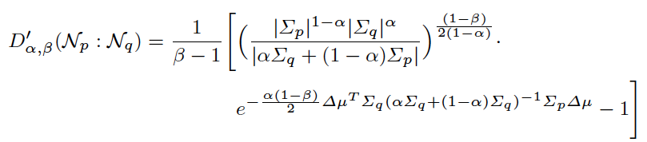
Sharma Mittal Divergence between two Gaussians
Our closed form expression (proof in Lemma 3.1)
Only one inverse
Details about computations could be found in the paper
Notes:
Perhaps, some terminologies are unclear and that's what we are going to conver in our introduction.

Slide 10
Sharma Mittal Divergence between two Gaussians
(Nielsen etal 2012) closed form expression
Our closed form expression (Lemma 3.1)
Our closed form expression (proof in Lemma 3.1)
Details about the detailed contrast between two could be found in the paper
Notes:
Perhaps, some terminologies are unclear and that's what we are going to conver in our introduction.

Slide 11
Agenda
1
Introduction
2
Sharma Mittal Divergence between Gaussian Distributions
3
Sharma Mittal TGPs (SMTGP)
4
Theoretical Analysis of SMTGP
5
Experiments
6
Conclusion and Future Work
Notes:
Let's introduce the problem in more detrails.

Slide 12
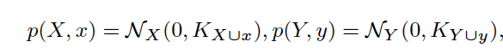
Twin Gaussian Process
Notes:
Perhaps, some terminologies are unclear and that's what we are going to conver in our introduction.

Slide 13
Twin Gaussian Process (TGP)
Notes:
Perhaps, some terminologies are unclear and that's what we are going to conver in our introduction.

Slide 14
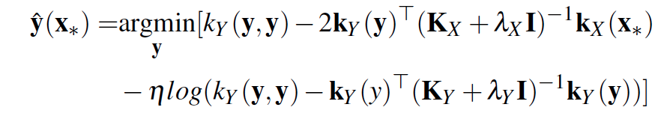
KL Twin Gaussian Processes (Bo etal 2010)
N × N gram matrix
N × N gram matrix
Notes:
Perhaps, some terminologies are unclear and that's what we are going to conver in our introduction.

Slide 15
How about Sharma Mittal TGP as a generic divergence measure ?
Notes:
Perhaps, some terminologies are unclear and that's what we are going to conver in our introduction.

Slide 16
BUT : There are two Two closed form Expressions for Sharma Mittal
(Nielsen etal 2012) closed form expression
Our closed form expression (Lemma 3.1)
Our closed form expression (proof in Lemma 3.1)
Details about the detailed contrast between two could be found in the paper
Notes:
Perhaps, some terminologies are unclear and that's what we are going to conver in our introduction.

Slide 17
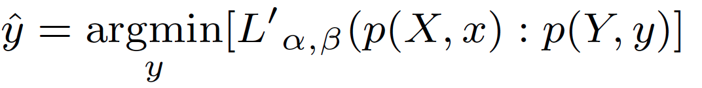
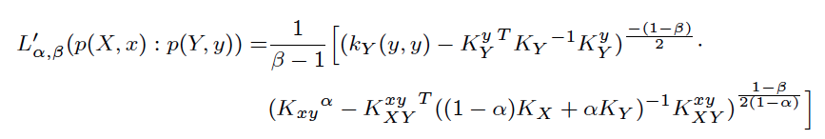
Sharma Mittal TGP (The long story short)
We developed two versions of Shama Mittal TGP based on
Neilson, 2012 closed form experresion
Our closed form expression.
The Sharma Mittal TGP based on our closed form expression turns out to be significantly faster (see details in the paper)
One aspect is quadratic gradient (ours)computation instead of cubic (Neilson) cubic
Notes:
Perhaps, some terminologies are unclear and that's what we are going to conver in our introduction.

Slide 18
Agenda
1
Introduction
2
Sharma Mittal Divergence between Gaussian Distributions
3
Sharma Mittal TGPs (SMTGP)
4
Theoretical Analysis of SMTGP
5
Experiments
6
Conclusion and Future Work
Notes:
Let's introduce the problem in more detrails.

Slide 19
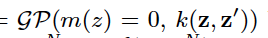
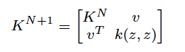
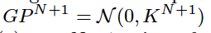
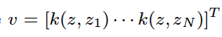
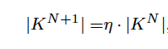
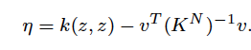
Theoretical Analysis
Gaussian Process
Let be a Gaussian Process on Z
is the marginalization of
Over N training points
Notes:
Let's start by Visual Classification and Fine grained recognition.

Slide 20
Theoretical Analysis
Gaussian Process
Interpretation of : the ratio by which the variance (uncertainty) of
the marginalized Gaussian process is scaled, introduced by the new
data point z (N+1 st).
Detailed justification could be found in the manuscript.
How this is useful for Analyzing Sharma Mittal TGP????
Notes:
Let's start by Visual Classification and Fine grained recognition.

Slide 21
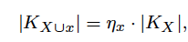
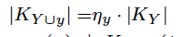
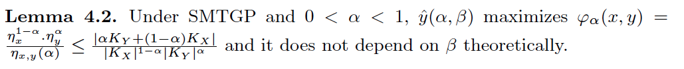
Theoretical Analysis
Sharma Mittal TGP cost function
There are three uncertainty expansions in this equatioon
\
Notes:
Let's start by Visual Classification and Fine grained recognition.

Slide 22
Theoretical Analysis
Notes:
Let's start by Visual Classification and Fine grained recognition.

Slide 23
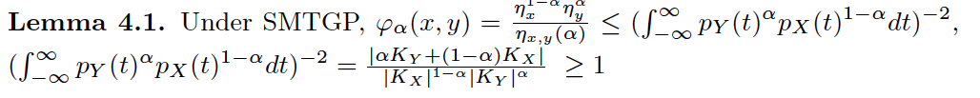
Theoretical Analysis
Detailed proof for each lemma could be found in the manucript
Notes:
Let's start by Visual Classification and Fine grained recognition.

Slide 24
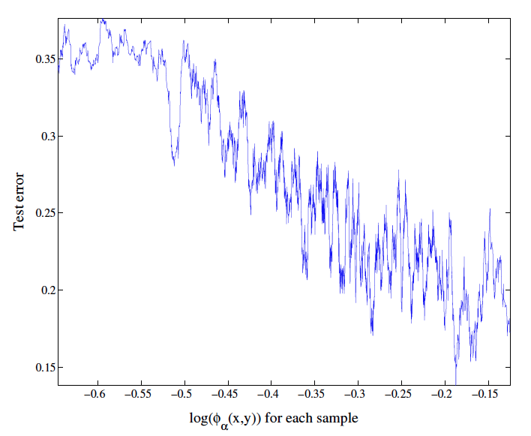
Sructured Regression Uncertainty Measure
Notes:
Perhaps, some terminologies are unclear and that's what we are going to conver in our introduction.

Slide 25
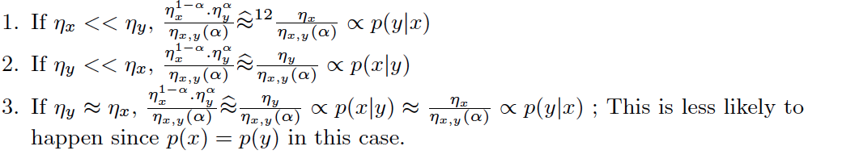
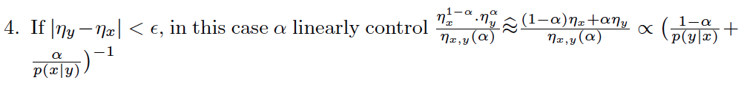
Probablistic Interpretation of
Notes:
Perhaps, some terminologies are unclear and that's what we are going to conver in our introduction.

Slide 26
Agenda
1
Introduction
2
Sharma Mittal Divergence between Gaussian Distributions
3
Sharma Mittal TGPs (SMTGP)
4
Theoretical Analysis of SMTGP
5
Experiments
6
Conclusion and Future Work
Notes:
Let's introduce the problem in more detrails.

Slide 27
Experimental Results
In addition to our theoretical results, we validated Sharma Mittal TGP on five datasets (two toy examples and three real datasets and covering uniquely
Toy regression, Human Pose estimation, and Image reconstruction
Data | Type/Task
Toy Example 1 | Toy Regression
Toy Example 2 | Toy Regression
Poser Dataset | Human Pose Estimation
Human Eva Dataset | Human Pose Estimation
USPS | Image Reconstruction
Notes:
Ass a slide with some pictures here for importance of Entropy measures

Slide 28
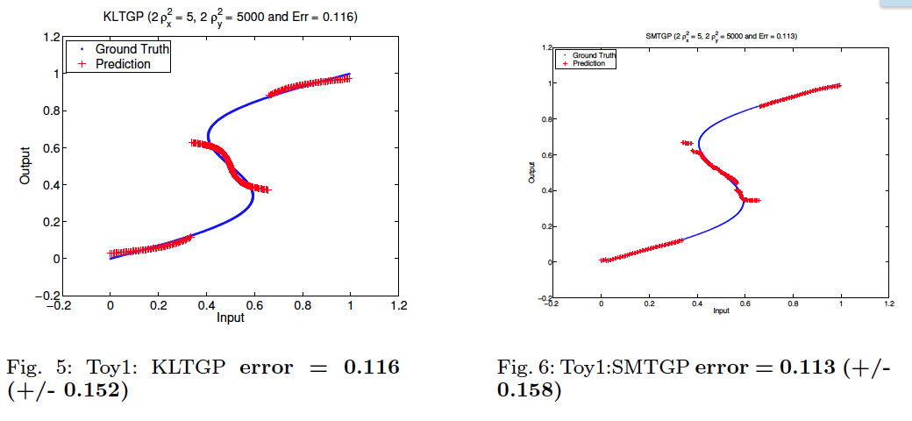
Experimental Results
Toy Example 1
Notes:
Perhaps, some terminologies are unclear and that's what we are going to conver in our introduction.

Slide 29
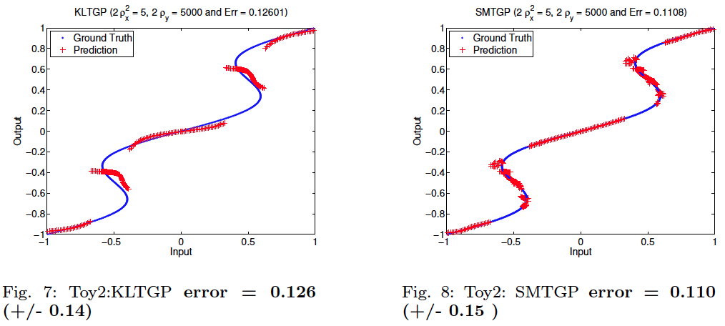
Experimental Results
Toy Example 2
Notes:
Perhaps, some terminologies are unclear and that's what we are going to conver in our introduction.

Slide 30
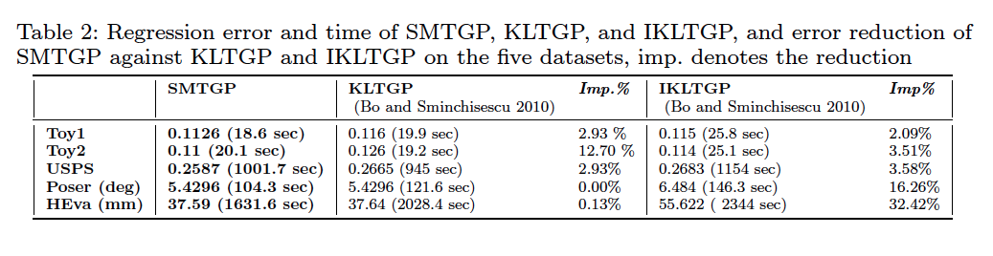
Experimental Results
Method
Dataset
IKLTGP worse than KLTGP
Notes:
Perhaps, some terminologies are unclear and that's what we are going to conver in our introduction.

Slide 31
Experimental Results
Method
Dataset
IKLTGP better than KLTGP
Notes:
Perhaps, some terminologies are unclear and that's what we are going to conver in our introduction.

Slide 32
Experimental Results
Method
Dataset
SMTGP error <= min (KLTGP error, IKLTGP error) in all datasets
Notes:
Perhaps, some terminologies are unclear and that's what we are going to conver in our introduction.

Slide 33
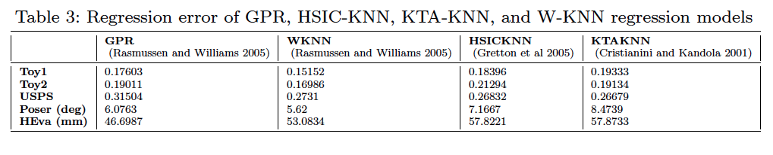
Experimental Results
Method
Dataset
SMTGP error <= min (KLTGP error, IKLTGP error, GPR, HSIC, KTA, WKNN) in all datasets
Notes:
Perhaps, some terminologies are unclear and that's what we are going to conver in our introduction.

Slide 34
Agenda
1
Introduction
2
Sharma Mittal Divergence between Gaussian Distributions
3
Sharma Mittal TGPs (SMTGP)
4
Theoretical Analysis of SMTGP
5
Experiments
6
Conclusion and Future Work
Notes:
Let's introduce the problem in more detrails.

Slide 35
Conclusion
Theoretical analysis of the two-parameter generalized Sharma-Mittal (SM) divergence measure for structured output prediction.
Alternative, yet equivalent, formulation for SM divergence whose gradient computation is quadratic compared to cubic for the structured output prediction task (Lemma 3.1)..
Theoretical properties which is concluded by a probabilistic causality direction of our SM objective function (Lemma 4.1, 4.2).
We performed extensive experiments to validate our ndings on different tasks and datasets
Two toy examples (Toy1 (Bo etal 2010), Toy2)
Two datasets for pose estimation (Poser, HumanEva)
One dataset for image reconstruction ().
Notes:
Ass a slide with some pictures here for importance of Entropy measures

Slide 36
Future Work
Developing a much faster version of our Sharma Mittal Regression and other kernel methods applicable. This could benefit from the ODC notion (Elhoseiny etal, BMVC15).
Applying Sharma Mittal Divergence on other machine learning tasks.
Learning Deep Representation under Shama Mittal cost
Notes:
Ass a slide with some pictures here for importance of Entropy measures

Slide 37

Poster is # B64
Acknowledgment NSF Award #1409683, USA
Notes:
----- Meeting Notes (4/17/14 19:14) -----
remove fancy

